Slide 1




FINAL REVIEW
Optimizing Software Effort Estimation Accuracy with a Machine Learning Model
Mr.D.Raghu Raman
Associate professor
IFET college of engineering,
Villupuram.
D.SANTHAGAROOBAN (201022101)
CSE / Final Year

Slide 2



Abstract
The software industry has experienced rapid expansion in recent years, with software development now essential to the success of many multinational corporations.
Cost and effort calculations significantly impact the development
process and client needs, and project failure is often caused by
errors in job estimating.
The ML model will be evaluated on its ability to predict effort accurately for new projects, with a focus on improving the accuracy of time, budget, member, and module estimations.

Slide 3
Introduction
In the dynamic realm of software development, accurately estimating effort is crucial for successful project completion within the constraints of time, budget, and resources.
Traditional effort estimation methods often fall short due to their subjective nature and inability to capture the complex interplay of factors that influence development effort.
This project aims to develop and optimize an ML model for software effort estimation, considering factors such as project size, complexity, team size, and module dependencies.

Slide 4
Literature Survey
Title of The paper | Description | Publication details
Heterogeneous Ensemble Model to Optimize Software Effort Estimation Accuracy | This paper is essential for planning and allocating resources, setting project timelines, and communicating project progress to stakeholders. Several approaches to software effort estimation exist, including expert judgment, algorithmic methods, and machine learning techniques. | IEEE 2023
Empirical Study of Homogeneous and Heterogeneous Ensemble Models for Software Development Effort | Thus,this paper developed different homogeneous and heterogeneous ensembles of some optimized hybrid of computational intelligence models for software development effort estimation | IEEE 2023

Slide 5
Existing System
This Ensemble model is essential for planning and allocating resources, setting project timelines, and communicating project progress to stakeholders. Several approaches to software effort estimation exist, including expert judgment, algorithmic methods.
The quality and maintainability of software projects could suffer from an underestimation of tasks (such as testing and documentation) that were to be abandoned or more staff were to be hired
Dept of CSE

Slide 6
Proposed System
To obtain high-effort estimation accuracy, professionals and academics have offered a variety of estimating approaches based on the before stated strategies.
The software development effort estimating in The Machine learning model was developed by using decision tree and random forest .

Slide 7
ADVANTAGE OF PROPOSED SYSTEM
ACCURACY IS HIGH
FASTER
USER FRIENDLY APPLICATION

Slide 8
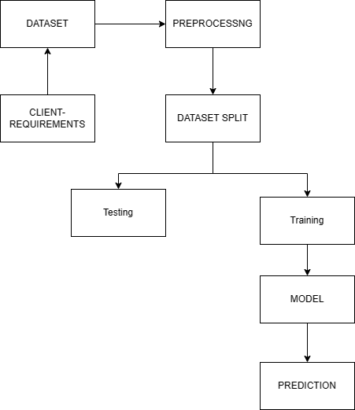
Block Diagram

Slide 9



SOFTWARE REQUIREMENTS:
Operating system : Windows
Coding Language : python
Front End : Html,CSS
Back End : SQlite
8

Slide 10
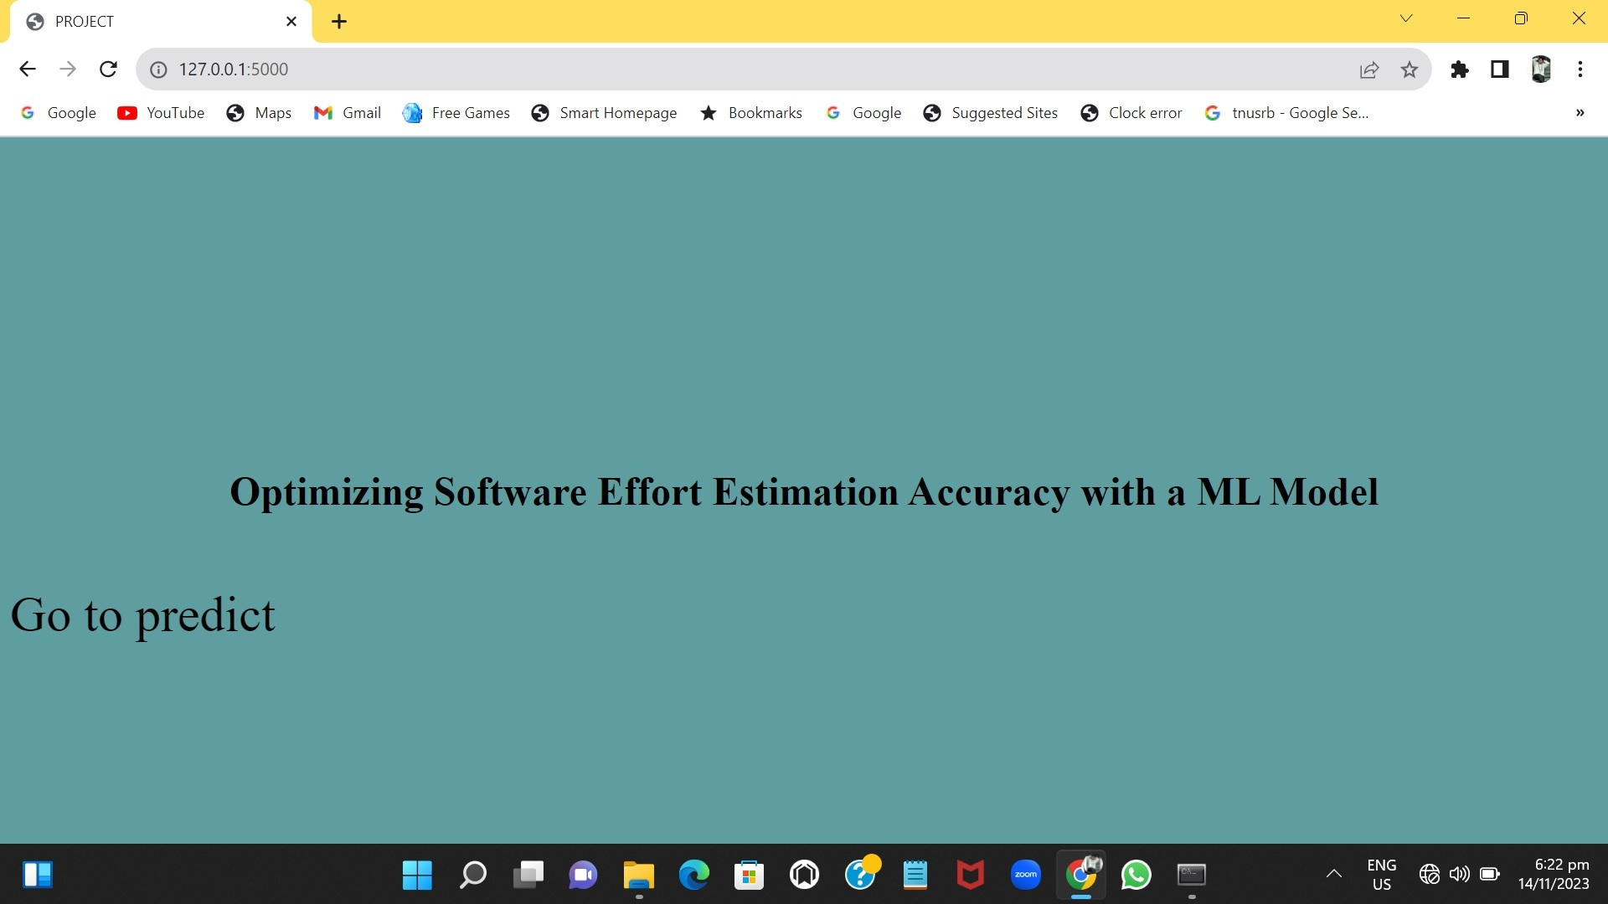
OUTPUT

Slide 11
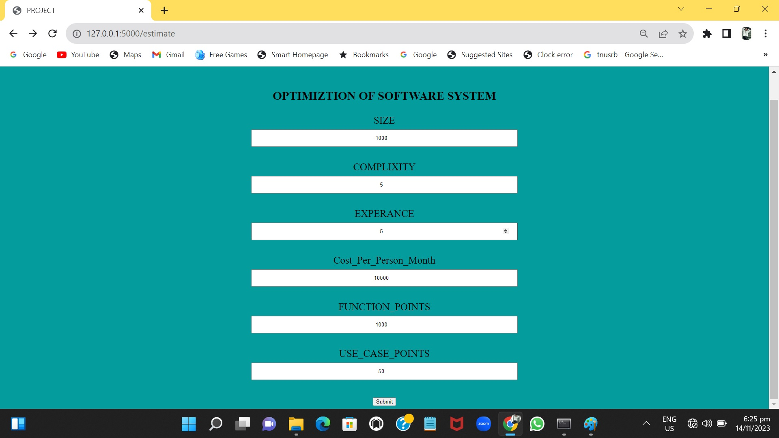

Slide 12
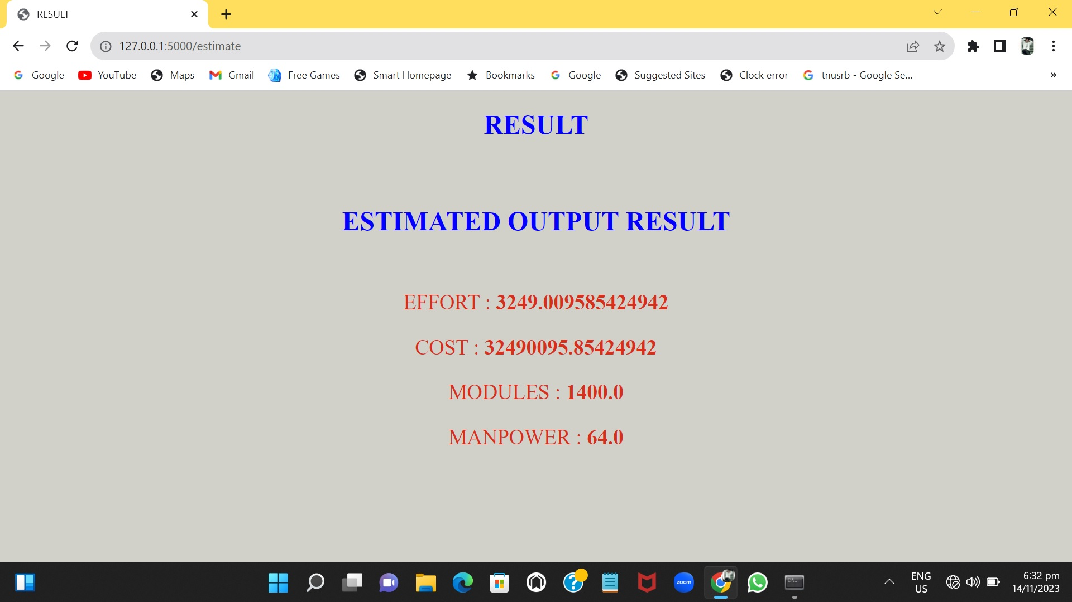

Slide 13
CONCLUSION
the project focused on optimizing software effort estimation accuracy through the integration of a machine learning model. The results showcase a significant improvement in predicting resource requirements, fostering more precise planning and resource allocation in software development. By harnessing the power of machine learning, we have not only enhanced accuracy but also paved the way for continuous refinement of estimation methodologies. This approach offers a promising avenue for industry-wide adoption, aiming to minimize project uncertainties, improve delivery timelines, and ultimately contribute to the efficiency and success of software development endeavors.

Slide 14
THANK YOU
Dept of CSE

